Slide 1
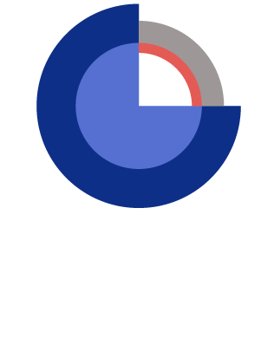
Problem formulation
Nikolai Andrianov, Nynke Keulen, Mette Olivarius, GEUS
25 October 2022

Slide 2
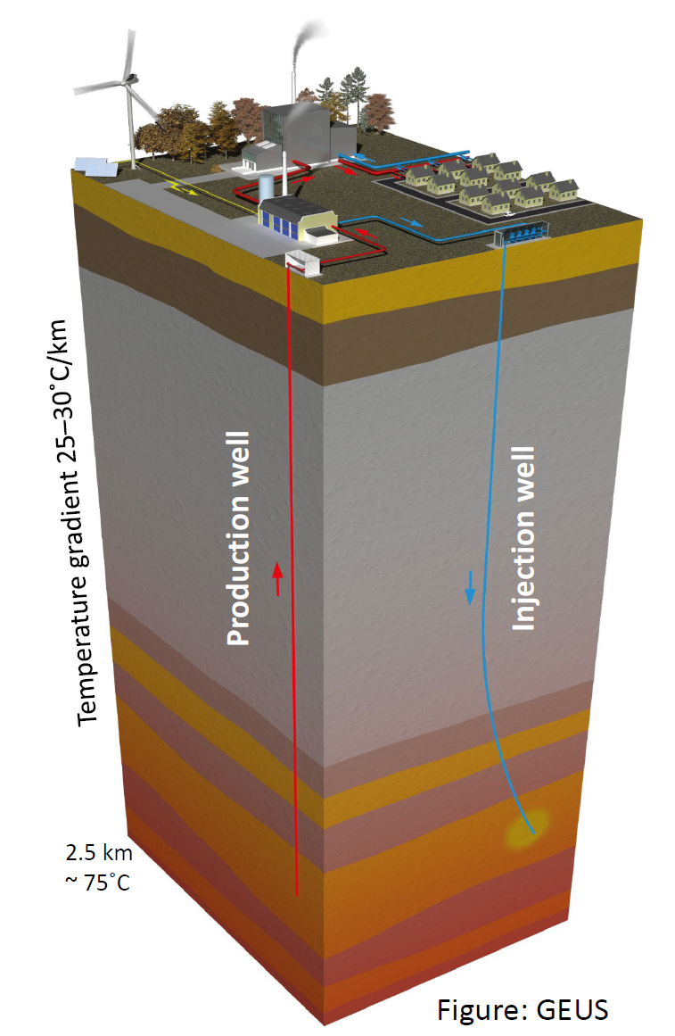
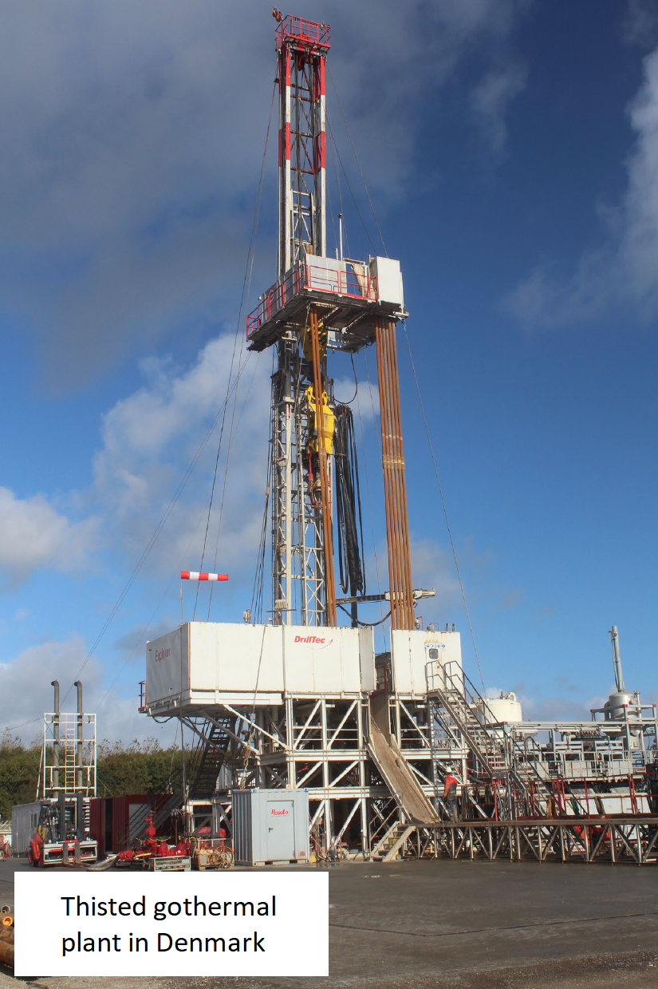
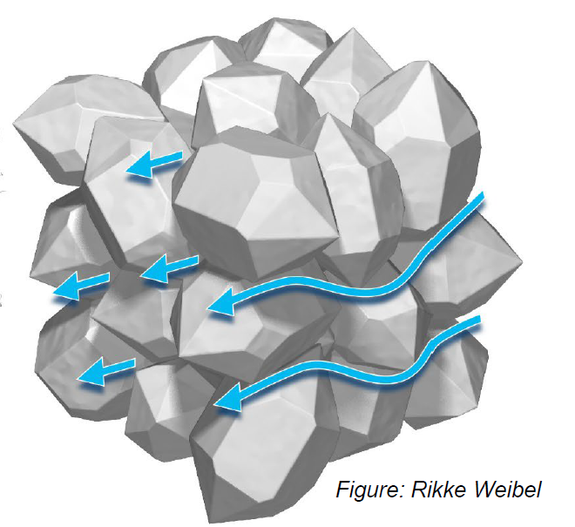
Context
Geothermal energy could play a significant role in ensuring access to affordable, reliable, sustainable and modern energy for all, but production today is only at 7% of the estimated global potential.
Understanding the structure of porous rocks is essential for the success of geothermal energy production.
Modelling of chemical transformations (diagenesis) in sediments after deposition can enable better pre-drill predictions of reservoir properties.
Of particular importance is an estimate of quartz cement (overgrowth), which precipitates during diagenesis.
Quartz cement:
Reduces permeability
Thisted geothermal
plant in Denmark
Figure: GEUS
Figure: GEUS

Slide 3
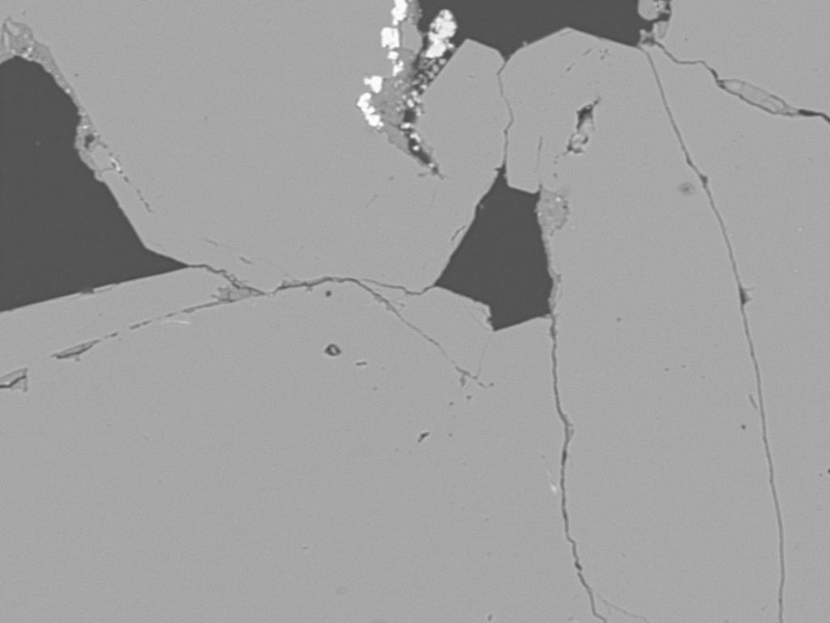
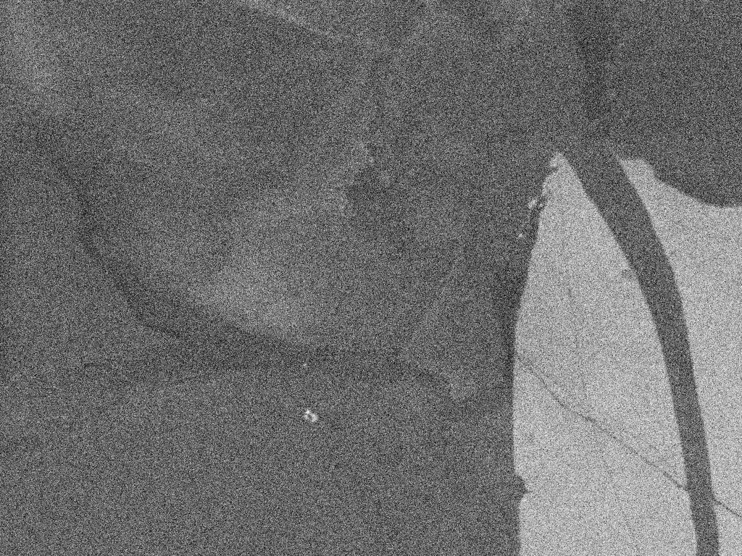

Goal of the competition
The goal of the competition is to segment Scanning Electron Microscope (SEM) images of sandstone rocks into areas occupied by detrital quartz grains (cores), their diagenetic overgrowths (rims), other minerals and pore space.
Three types of images are available:
The backscattered electron (BSE) images are generally characterized by high contrast between minerals (mainly quartz) and the pore space. However, the distinction between quartz and its overgrowths cannot be made using the BSE images.
The cathodoluminescence (CL) images allow for distinction between the quartz grains and their overgrowths, where overgrowths have lower grey values than the original grains. Due to technical reasons, the field of view for the CL images is generally shifted with regards to the corresponding BSE images by up to 10% of the images’ dimensions.
The mineral maps (MM) provide the information on the minerals, which constitute the rock grains. However, this information is available at a coarser scale as compared to the BSE and CL images. The field of view for the MM images is the same as for the corresponding BSE images.
BSE
CL
MM

Slide 4

Dataset description
Keulen, Olivarius, Andrianov, 2022, "Scanning electron microscope images dataset for geothermal reservoir characterisation", https://doi.org/10.22008/FK2/5TWAZK, GEUS Dataverse. Updated version 25/10/2022.
Open sourced under the CC BY license – no restrictions to use once you cite it ☺
The license description is available at https://creativecommons.org/licenses/by/4.0/legalcode
Contains the archived datasets:
Dataset 1:
Files dataset1_BSE.zip, dataset1_CL.zip, dataset1_MM.zip
Upon extraction, each of the folders BSE, CL, and MM contains 1017 images
Images are characterized by nearly only quartz and large overgrowths
Dataset 2:
Files dataset2_BSE.zip, dataset2_CL.zip, dataset2_MM.zip
Files dataset2B_BSE.zip, dataset2B_CL.zip, dataset2B_MM.zip
Upon extraction, each of the folders BSE, CL, and MM contains 2046 images
Images are characterized by the presence of both quartz and feldspar with clear overgrowths
Dataset 3:
Files dataset3_BSE.zip, dataset3_CL.zip, dataset3_MM.zip
Upon extraction, each of the folders BSE, CL, and MM contains 569 images
Images are characterized by mainly quartz, many other minerals in the pores between quartz and large overgrowths
Dataset 4:
Files dataset4A_BSE.zip, dataset4A_CL.zip, dataset4A_MM.zip
Files dataset4B_BSE.zip, dataset4B_CL.zip, dataset4B_MM.zip
Upon extraction, each of the folders BSE, CL, and MM contains 705 images
Images are characterized by nearly only quartz with low contrast in the CL images and small overgrowths
All images have the same resolution of 1024x768 pixels

Slide 5
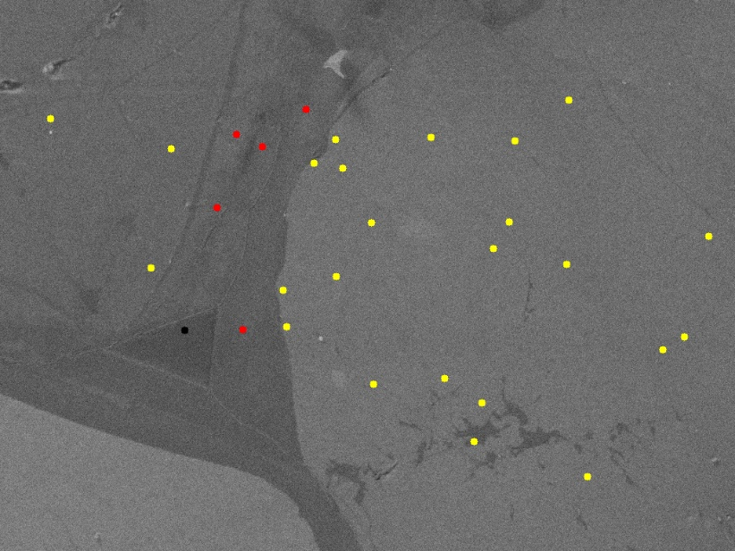
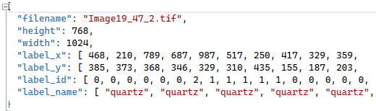
Labelled dataset
200 CL images from Dataset 1 have been labelled by GEUS into the 4 categories, including quartz (ID=0), quartz overgrowths (ID=1), pore space (ID=2), and other minerals (ID=3).
Each team must classify their images into these 4 categories (ID=0-3).
For each of the labelled images, only 30 pixels are assigned with labels.
The CL images and their corresponding labelling information will be available in JSON file labelled_images.json available on Discord
The records structure in JSON contains the image file name, image dimensions, coordinates of labels, labels’ numerical ID and the text names.

Slide 6
The workflow and deliverables from the hackathon participants
1. Final ML model (able to classify CL into 4 categories)
Unlabelled datasets (BSE, CL, MM, dataset1-4)
?
2. The report (1500-2000 words)
30-pixel labelled dataset
(200 CL)
3. Video pitch (5 minutes)
Input from GEUS (25th Oct)
Final submission (25th Nov)
The Energy GeoHackathon (25th Oct - 25th Nov)
Bonus assignment:
classify CL into 6 categories including feldspar grains and feldspar overgrowths

Slide 7
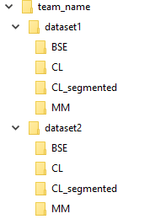

1. Final ML model
* A Python 3.x script (not a notebook) called run.py and eventual accompanying scripts should be able to:​ classify all the images in the CL directory using the following colours (in hexadecimal RGB codes): quartz – yellow (ffff00), quartz overgrowths – red (ff0000), other minerals – green (00ff00), pores – black (000000).
* The model should be executed in a root directory <team_name> with the subfolders dataset1 and dataset2 etc., each of them containing the corresponding images from the dataset in the subfolders BSE, CL, and MM.
* The model should be able to create the subfolders dataset1/CL_segmented and dataset2/CL_segmented etc. with the results of the segmentation. The segmented images should be TIF files and should have the same file names as their CL, BSE, and MM counterparts.
* The model should create a CSV file results_dataset1.csv and results_dataset2.csv etc. with the relative areas of quartz grains, quartz overgrowths, other minerals, and pores for each image in the corresponding CL subfolder. The structure of the CSV files should be as follows:
* Please submit 5 segmented images of each dataset (20 in total) along with your model. These images will be used to ensure that the model is running correctly on our local machine.

Slide 8
2. Report and video presentation

Slide 9

Final submission and judging
Each team should submit 2 compressed files at the end of the GeoHackathon.
File 1 should contain the ML model.
File 2 should contain the report (PDF format) and the video pitch.
So each team, please create 2 folders. Put the name of your team and the number of the file in each folder. For example teamname_1 (contains the ML model), teamname_2 (contains the report and the video)
Please put each item in the corresponding folder. Then compress each folder (.zip, .rar) and submit your compressed files via the link below.
https://forms.gle/qiSUL4R5dmnFDNcm9
Your response will be editable till the deadline. So please edit your response if needed rather than submitting a new form.
All code submissions are required to be licensed under an open license, preferably the MIT license.
The ML model will be assessed using a testing dataset, which will not be available to the hackathon participants during the competition.
The split of the evaluation points is as follows
Python solution: 60% of the points
Report: 30% of the points
Video: 10% of the points

Slide 10

Bonus assignment
In case you participate in the bonus assignment and define feldspar grains and feldspar overgrowths as well on Dataset 2, the final ML model should be modified as follows:
A Python 3.x script (not a notebook) called run.py and eventual accompanying scripts should be able to:​ classify all the images in the CL directory using the following colours (in hexadecimal RGB codes): quartz – yellow (ffff00), quartz overgrowths – red (ff0000), other minerals – green (00ff00), pores – black (000000), feldspar: purple (cc00ff), feldspar overgrowth: blue (3333ff).
The model should create a CSV file results_dataset2.csv with the relative areas of quartz grains, quartz overgrowths, other minerals, pores, feldspar grains and feldspar overgrowths for each image in the corresponding CL subfolder. The structure of the CSV files should be as follows:
All other parts of the submission should be created as for the regular assignment

